Slide 1
Mind your weight(s)
Vikramadithya Ivaturi & Swarnavo Chakrabarti

Slide 2
AGENDA
Introduction
Background and research problem
Approach applied
Your enhancement beyond the work
Your learning from the paper
Re-implementation of the work

Slide 3
INTRODUCTION
On-device machine learning (ML) is quickly gaining popularity among mobile apps. It allows offline model inference while preserving user privacy. However, ML models, considered as core intellectual properties of model owners, are now stored on billions of untrusted devices and subject to potential thefts. Leaked models can cause both severe financial loss and security consequences.
This paper presents the first empirical study of ML model protection on mobile devices. Our study aims to answer three open questions with quantitative evidence:
1.How widely is model protection used in apps?
2.How robust are existing model protection techniques?
3.What impacts can (stolen) models incur?

Slide 4
Background and research problem

Slide 5
The trend of on-device ML
Currently there are 2 ways of deploying ML with respect to mobiles: Cloud-based & On-device
In cloud-based ML, apps send requests to a cloud server, where the ML inference is performed, and then retrieve the results.
In On-device ML, apps directly feed the data and get the results in real time without sending any data to the cloud. Thereby achieving better user data protection.
Mobile app developers are quickly adopting the on-device ML approach for several reasons. This is now boosted with the AI chips in the mobile.
Apple’s Bionic neural engine, Huawei’s neural processing unit, and Qualcomm’s AI-optimized SoCs.

Slide 6
On-device Machine Learning Solution Providers
The popular providers of ML solutions and services include Face++ and SenseTime, which sell offline SDKs (including on device models) that offer facial recognition, voice recognition, liveness detection, image processing, Optical Character Recognition (OCR), and other ML functionalities.
By purchasing a license, app developers can include such SDKs in their apps and use the ML functionalities as black-boxes.
Now, if the ML model is leaked, it would seriously damage their business.

Slide 7
Approach applied

Slide 8
Analysis overview
We are not proposing any novel way of stealing or leaking ML models from apps, but we are trying to find out how realistic is it to leak or steal ML models from apps. So, we are indirectly representing knowledgeable yet not extremely skilled attacker.
Apps first go through the static analyzer, ModelXRay, which detects the use of on-device ML and examines the model protection, if any, adopted by the app.
ModelXtractor represents a realistic attacker who attempts to steal the ML models from an app installed on her own phone.

Slide 9
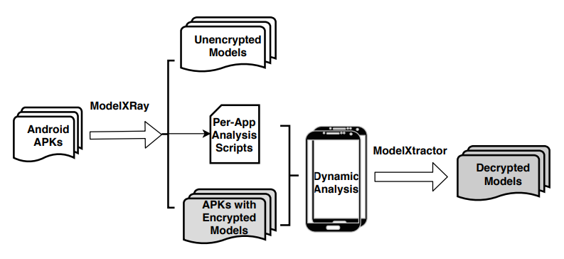
Analysis overview

Slide 10
Methodology of ModelXRay
ModelXRay detects if an app uses on-device ML and weather or not its models are protected, by analyzing the APK files of the application.
ModelXRay has the following methods to analyze the ML models.
Searches through binaries for native ML libraries using keyword search.
Uses a hybrid approach of matching file suffix, file size analysis to reduce false positives.
Analyzes file entropy to check if the model is encrypted.

Slide 11
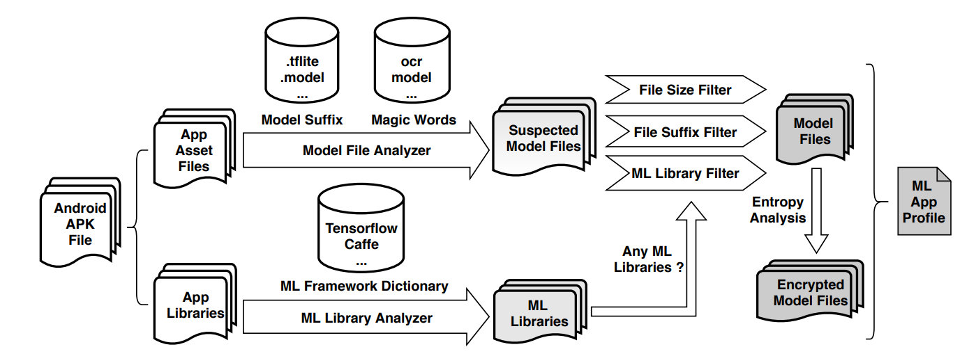
Methodology of ModelXRay

Slide 12
Methodology of ModelXtractor
ModelXtractor uses app instrumentation to dynamically find the memory buffers where (decrypted) ML is loaded and accessed by the ML frameworks.
ModelXtractor automatically generates the code that needs to be inserted at different instrumentation points. It employs the widely used Android instrumentation tool, Frida, to perform code injection.
ModelXtractor has 1 default strategy (S0), and 4 alternate strategies (S1-S4).

Slide 13
Methodology of ModelXtractor
S0 – Capture at model Deallocation
We try to capture the model right before buffer de-allocation time.
This is because models are completely loaded and decrypted when their buffers are freed.
This might fail due to some uncommon scenarios.
S1 - Capture from Heap
This strategy dumps the entire heap region of an app when a ML functionality is in use, in order to identify possible models in it.
S2 - Capture at Model Loading
This strategy instruments ML framework APIs that load models to buffers. We manually collect a list of such APIs for the ML frameworks observed in our analysis.

Slide 14
Methodology of ModelXtractor
S3 - Capture at Model Decryption
This strategy instruments model decryption APIs (e.g., aes256_decrypt) in ML frameworks, which we collected manually.
S4 - Capture at Customized Deallocation
Some apps use customized memory deallocators. We manually identify a few such allocators (e.g., slab_free), which are instrumented similarly as S0.

Slide 15
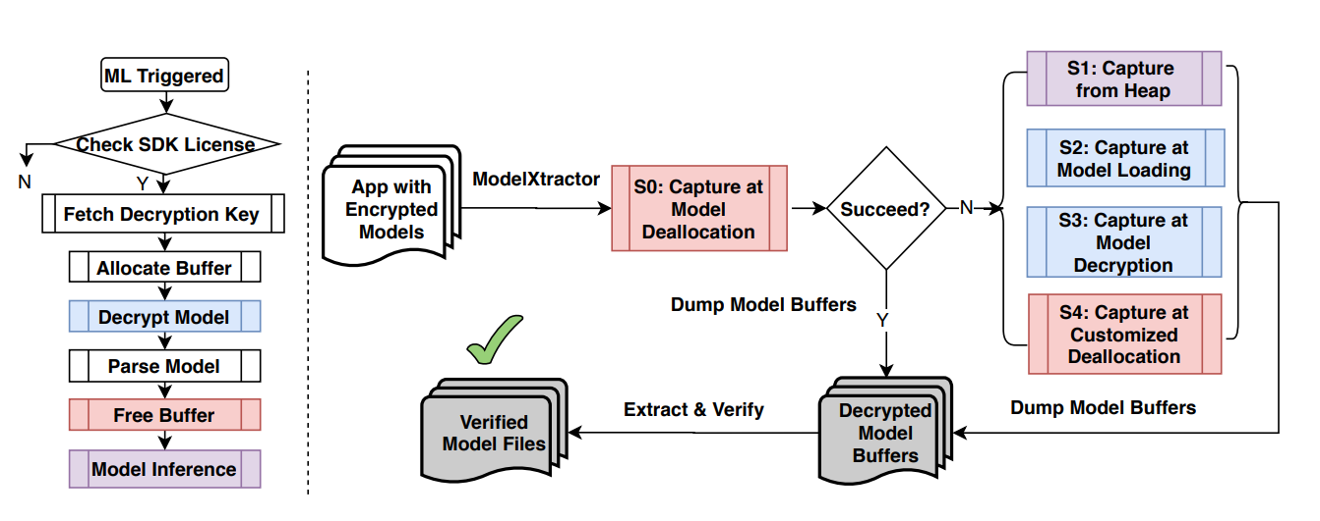
Methodology of ModeLxtractor

Slide 16
Protected vs unprotected
​ | Google Play | Tencent My App | 360 Mobile Assistant | Total​
Protected | 172 | 199 | 1897 | 2268
Unprotected | 757 | 666 | 2831 | 4254

Slide 17
Things we have learnt

Slide 18
AREAS OF FOCUS
ML Model Security
Consequence of poor security
learned about the importance of protecting machine learning models in mobile apps, as they are increasingly being used to process sensitive data such as personal health information and financial data.
The paper highlights the need for increased awareness and attention to the security risks associated with machine learning models in mobile apps.
Financial Benefits for Attackers
Pricing Disadvantages for Vendors
Anticipated Falling Market Share for Vendors
Security impact of an ML model (e.g., ID theft)
​

Slide 19
SUMMARY
The analysis in the paper shows that on-device machine learning is gaining popularity in every category of mobile apps, however, 41% of them are not protecting their models.
Our impact analysis shows that model leakage can financially benefit attackers with as high as millions of dollars and allow attackers to evade model-based authentication and access user private information. Attackers both technically can and financially are motivated to steal models

Slide 20
THANK YOU
Vikramadithya Ivaturi
ivatv01@pfw.edu
Swarnavo Chakrabarti
chak05@pfw.edu

